Slide 1
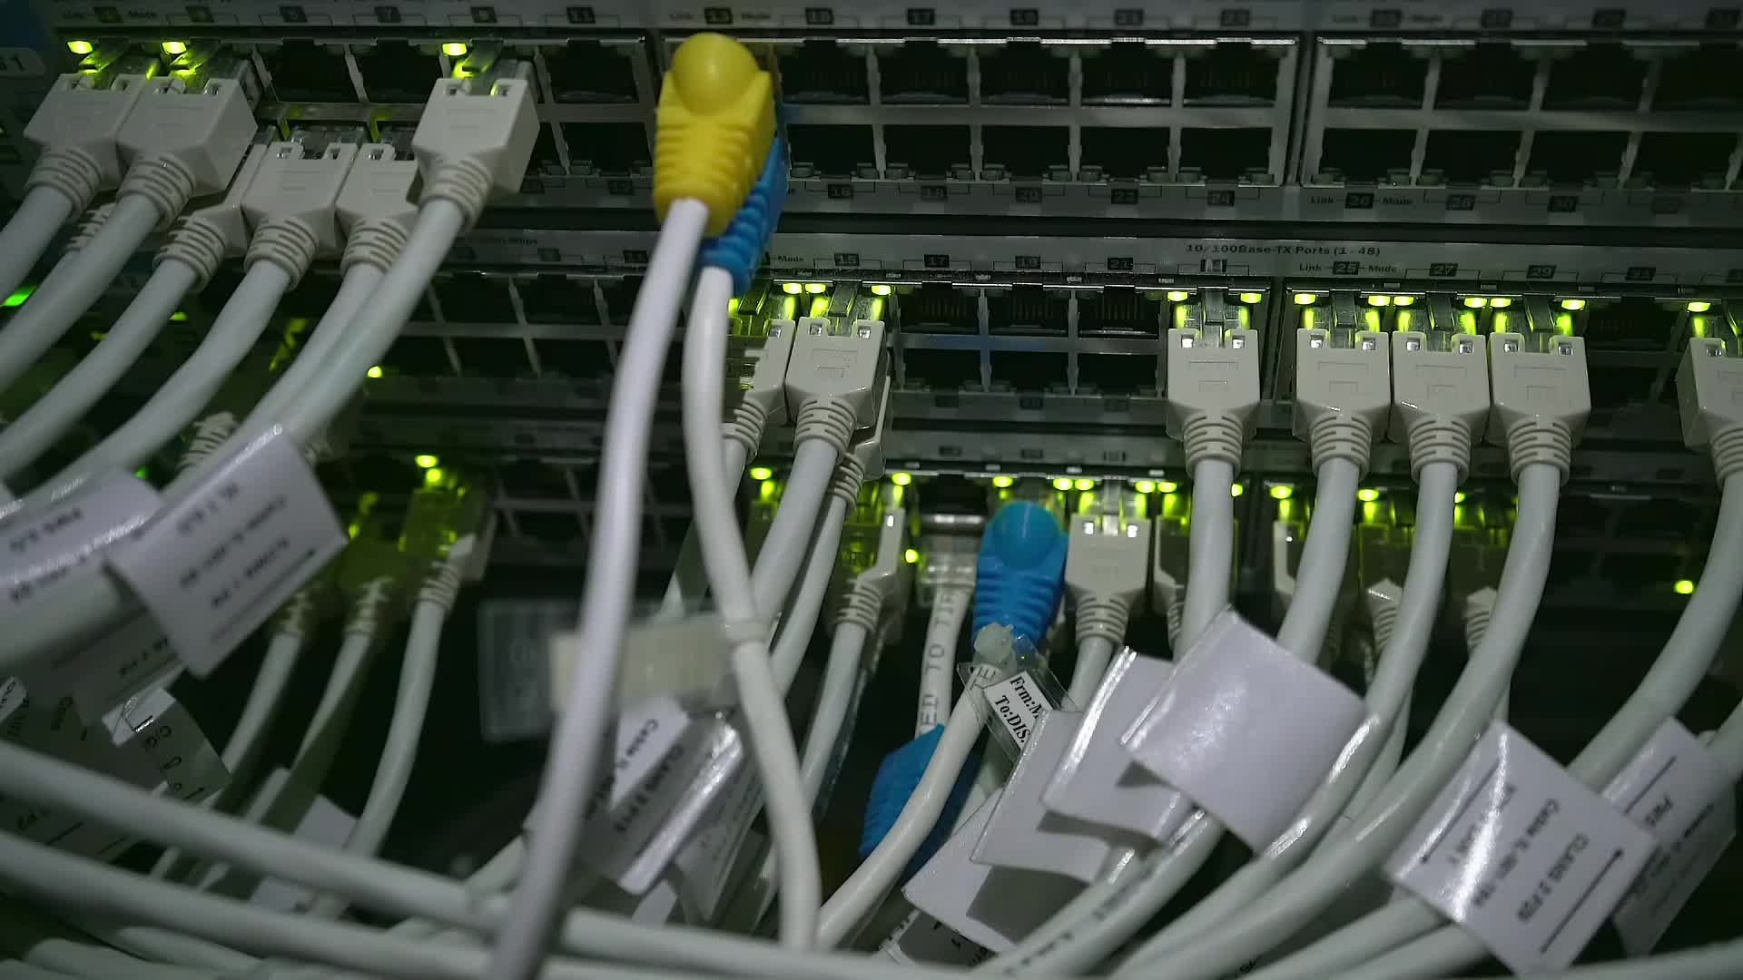
AWS Security Group vs Network ACL
SG & NACL

Slide 2
Common Points
Both are firewalls in AWS VPC networking.
Both control inbound and outbound traffic.
Both work at different layers of the VPC networking stack.

Slide 3
Security Groups (SG)
Where They Live
Attached to instances (EC2, RDS, ECS, ENI, etc.).
Rules apply only to the specific resource they are attached to.
Scope
Resource-level firewall (fine-grained control at instance/ENI level).

Slide 4

Default Behavior
Outbound: Allow all traffic by default.
Inbound: Deny all traffic unless explicitly allowed.
Stateful Nature
SGs are stateful.
If you allow inbound traffic on port 80, the outbound response is automatically allowed (no need for a separate outbound rule).
Rules
Only Allow rules supported (no Deny).
Define which IP, port, or protocol is allowed.
Cannot blacklist an IP (must use NACL or other service for that).

Slide 5

Limits
Up to 5 Security Groups per ENI (expandable to 16).
60 inbound + 60 outbound rules per SG (120 total).
IPv4 and IPv6 rules counted separately.
Use Case
Provide fine-grained firewall control at the instance level.
Commonly used to:
  Allow HTTP/HTTPS access to a web server.
  Allow SSH/RDP access only from specific IP ranges.

Slide 6

Network Access Control Lists (NACLs)
Where They Live
Attached at the subnet level.
Rules apply to all resources inside the subnet.
Each subnet can have only one NACL (but a NACL can be shared across multiple subnets).
Default Behavior
Default NACL → allows all inbound and outbound traffic.
Custom NACL → denies all inbound and outbound traffic until rules are added.
Stateless Nature
NACLs are stateless.
If you allow inbound traffic on port 80, you must also add an outbound rule for port 80 (responses are not automatic).

Slide 7

Rules
Support both Allow and Deny rules (unlike Security Groups).
Useful for blocking malicious IPs at subnet level.
Each rule has a rule number (1–32766).
Lower numbers = higher precedence.
Evaluation:
  First matching rule is applied.
  Example:
    Rule #100 = ALLOW 10.0.0.10/32
    Rule #200 = DENY 10.0.0.10/32
    Result → Allowed (because #100 matched first).
Last rule is always * (asterisk) → Denies traffic if no match is found.
AWS recommends using increments of 100 (100, 200, 300…) for flexibility.

Slide 8

Limits
1 NACL per subnet.
200 NACLs per VPC (soft limit, can be increased).
20 inbound + 20 outbound rules per NACL.
IPv4 and IPv6 rules counted separately.
Use Case
Provide broad subnet-level firewall policies.
Add an extra layer of defense alongside Security Groups.
Ideal for blocking specific malicious IPs

